Slide 1
PLEASE HELP!
Quick, Anonymous
Survey for
FINAL PROJECT
By: Sherwin Shirazi and Ryan Smith

Slide 2
Goals of our survey
Estimate the amount of time UGA students study, exercise, work, and relax
Determine which students at UGA are more likely to take surveys
Try to build a model to predict grades based on different combinations of variables

Slide 3
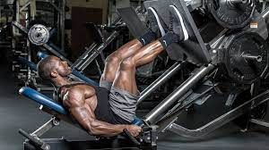
How we collected our data
Good old fashion leg work

Slide 4
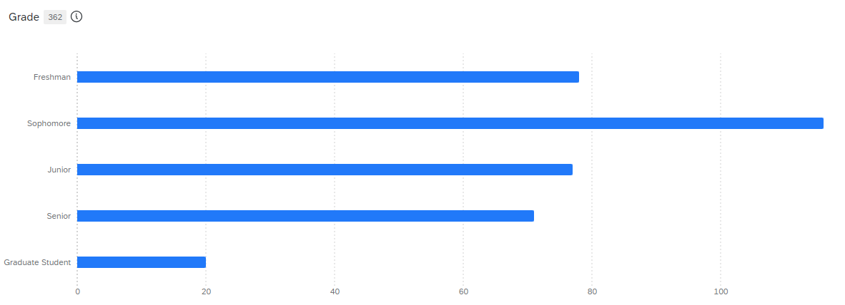
Year

Slide 5
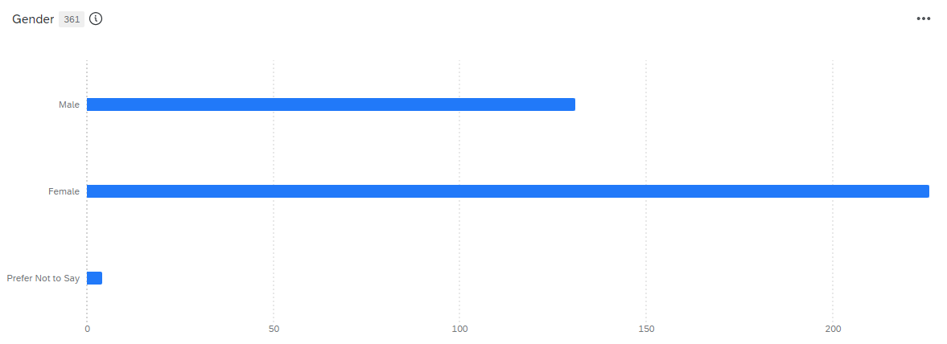
Gender

Slide 6
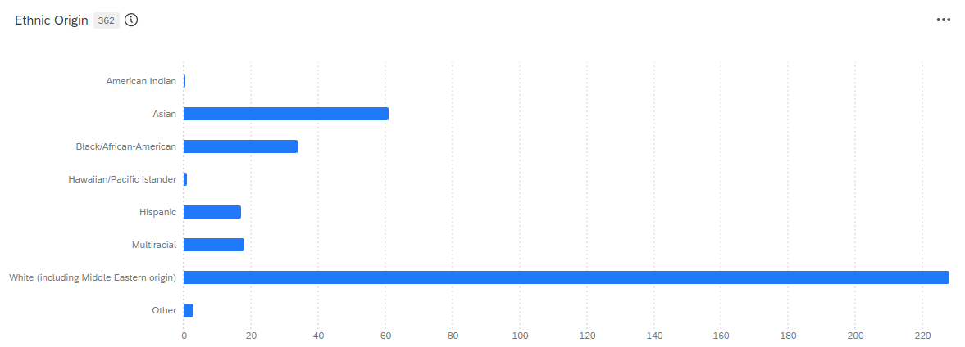
Ethnicity

Slide 7
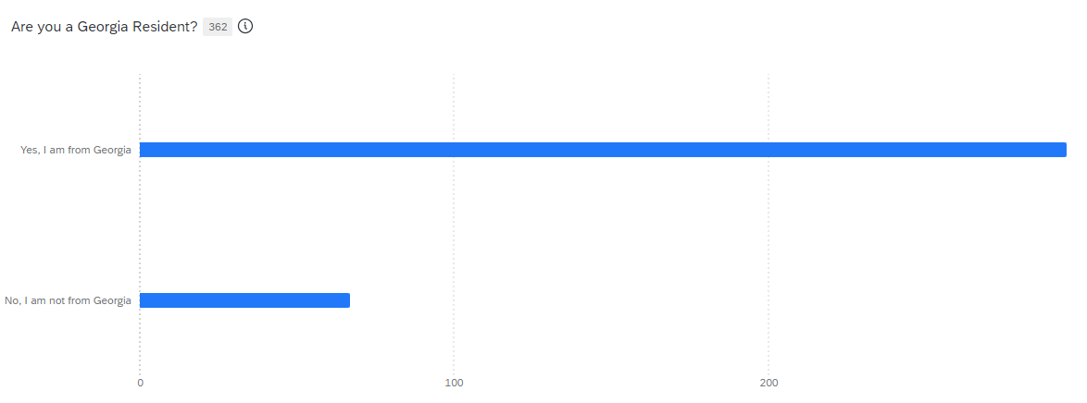
Georgia Resident

Slide 8
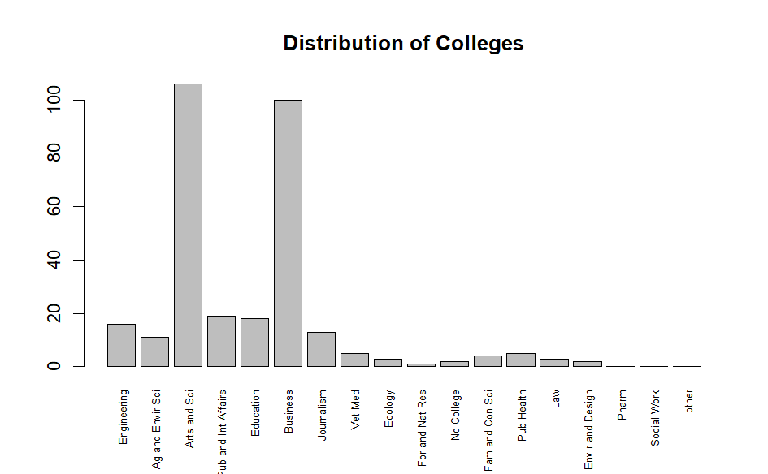
College

Slide 9
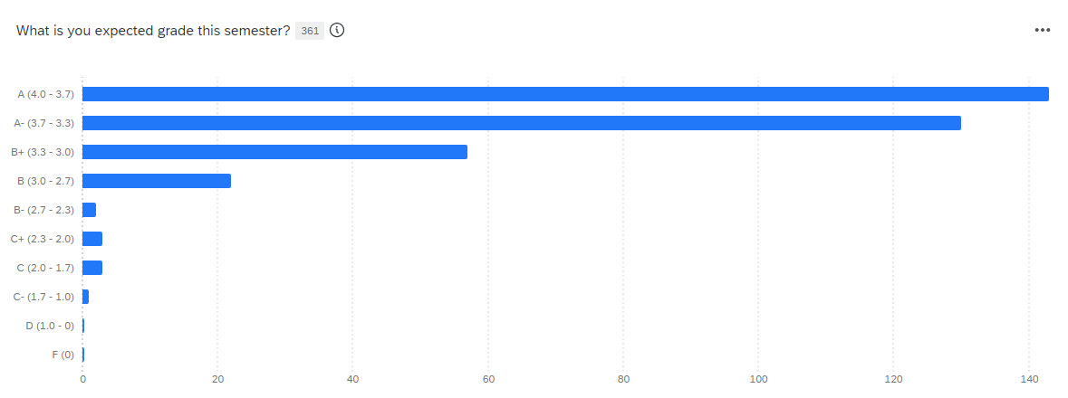
Expected Grade

Slide 10
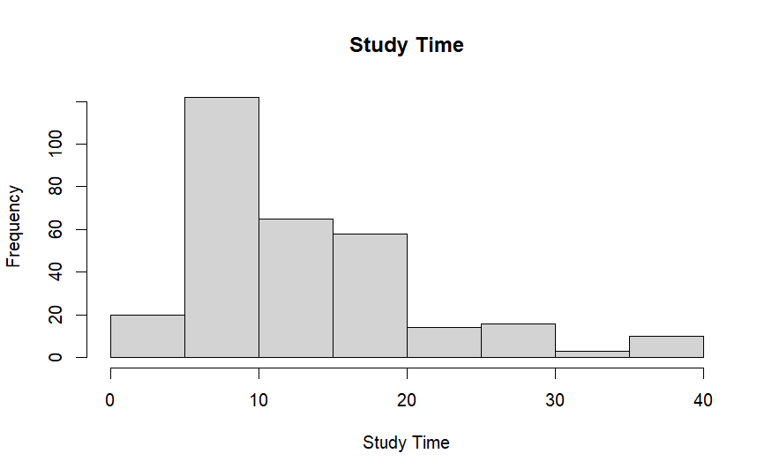
Study Time

Slide 11
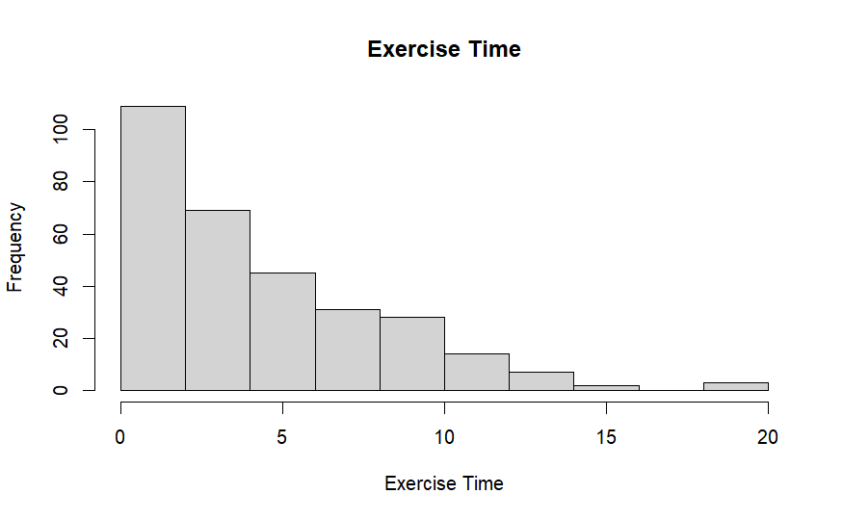
Exercise Time

Slide 12
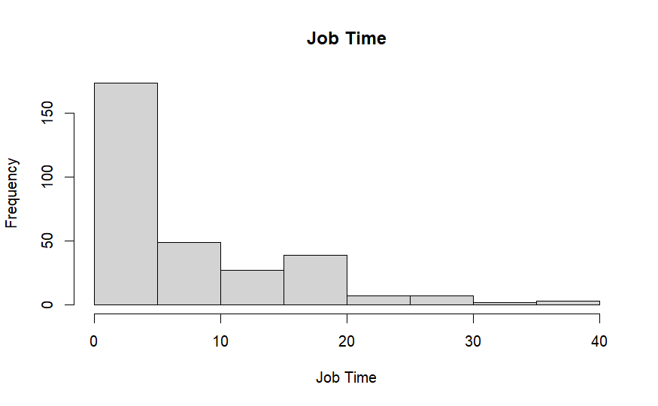
Job Time

Slide 13
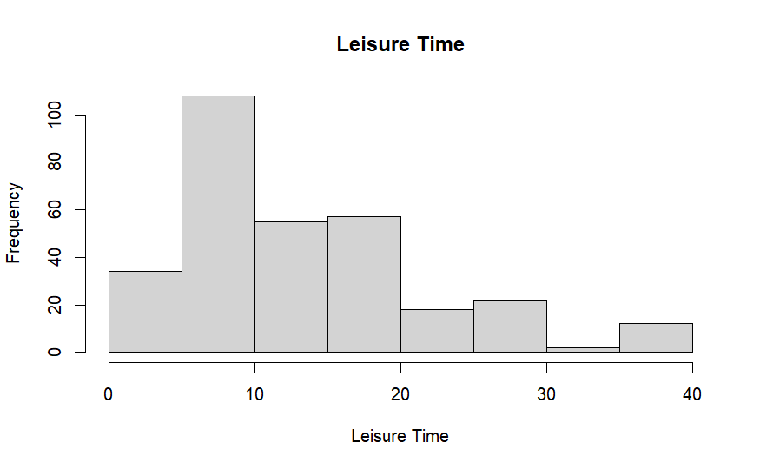
Leisure Time

Slide 14
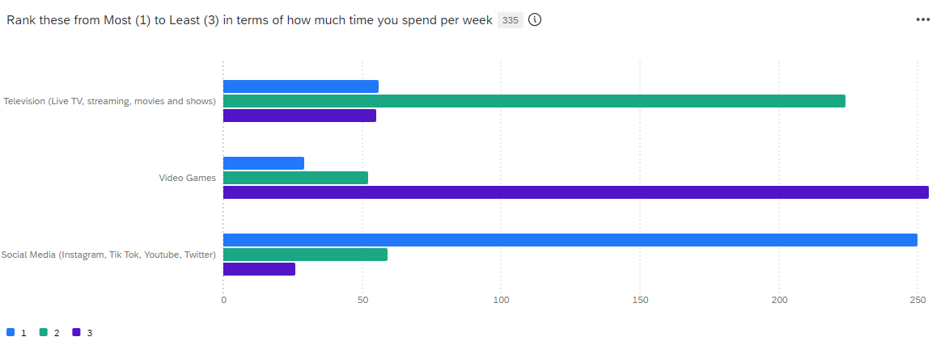
Entertainment Preferences

Slide 15
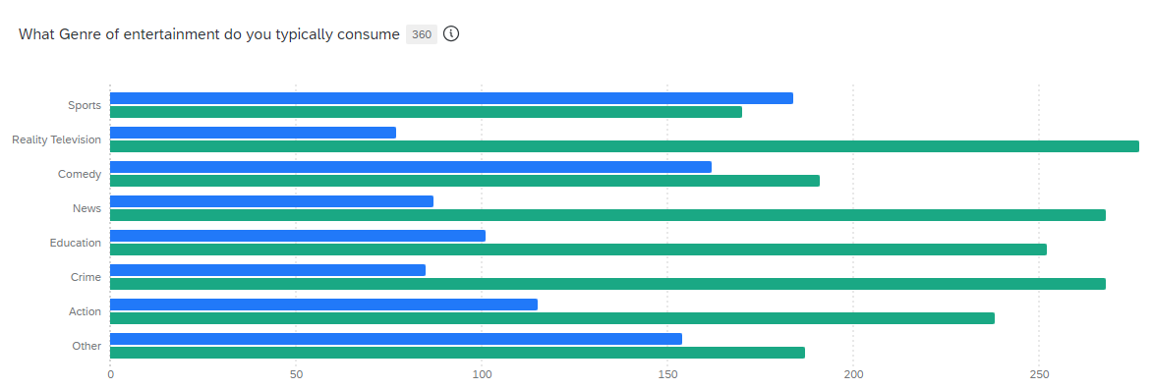
Genre Preference

Slide 16

Estimate for Study Time
Full Data Estimate = 13.92 hours
Weighted Estimate = 19.18 hours

Slide 17

Estimate for Job Time
Full Data Estimate = 6.71 hours
Weighted Estimate = 12.45 hours

Slide 18
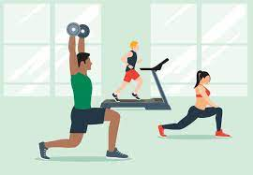
Estimate for Exercise Time
Full Data Estimate = 5.11 hours
Weighted Estimate = 4.68 hours

Slide 19
Estimate for Leisure Time
Full Data Estimate = 14.07 hours
Weighted Estimate = 13.36 hours

Slide 20
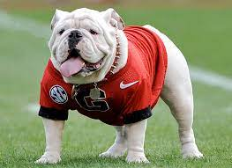
Who is more likely to take a Survey?
UGA Total Population = 40607

Slide 21
Year
Freshman and Sophomores answer survey a lot more than expected.
Juniors answer survey about as expected
Seniors answer survey a little less than expected.
Graduate students answer survey a lot less than expected.

Slide 22
Gender
Male and females answer survey about as expected
Prefer not to say (which we are considering as other genders) answer survey more than expected.

Slide 23
Ethnicity
American Indian, Hispanic, Multiracial, and White answer survey as expected
Asians, Hawaiian/Pacific Islander, and Other answer survey more than expected
Blacks/African-American answer survey less than expected

Slide 24
GA Residency
In-state and Out-of-State student answer survey as expected

Slide 25
College
Engineering, Agriculture and Environmental Science, Arts and Sciences, Journalism and Mass Communication, Vet Med, Ecology, Forestry and Natural Resources, No college, Public Health, Law, Environment and Design, and Other answer survey as expected
Public and International Affairs and Business answer survey more than expected
Education, Family and Consumer Science, Pharmacy, and Social Work answer survey less than expected

Slide 26
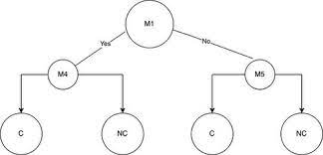
Decision Tree
What is a decision tree
Why we decided to use one
How to use one

Slide 27
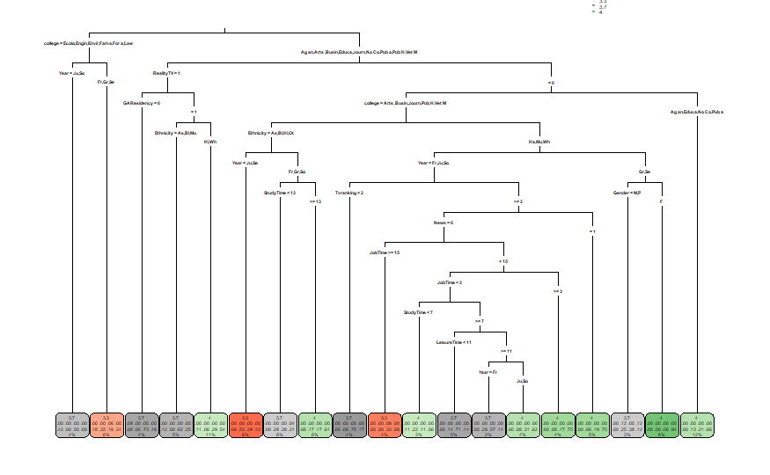
Model With All Factors
Accuracy=0.601

Slide 28
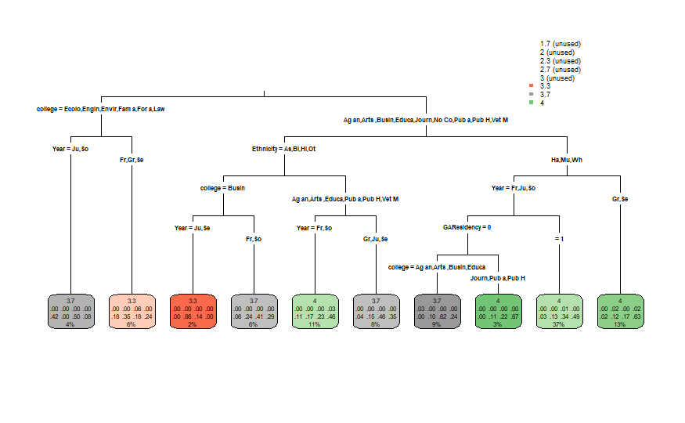
Model With Demographic Data
Accuracy=.516

Slide 29
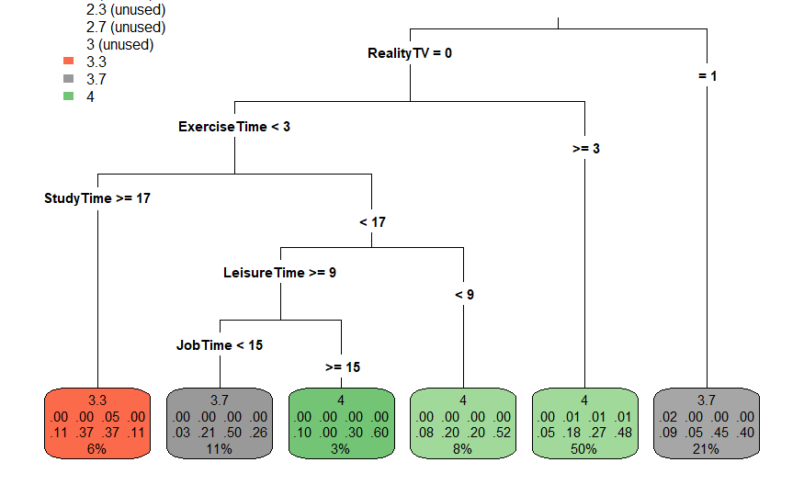
Model With Survey Data
Accuracy=.474

Slide 30
Possible Biases
Location
Time Of Day
Lying about GPA

